Slide 1

Tools, badges, and boards: reverse engineering and building hardware
Conrad Franke

Slide 2
Agenda
1) Background and what were going to build
1) EE Components, electrical design, and components
2) What hardware can be built with pcb tool kicad
3) inspecting and reverse engineering a schematic /reverse engineering hardware demo with tools
4) making a schematic
5) building a PCB badge from the reverse engineered schematic and exporting it to gerber files for fabrication that the audience can bring to future conferences as a PCB
6) discussing hardware and tools used by engineers
7) discussing hardware implants and tools used by hackers
7) Summary

Slide 3
Background about me
-Small town in northern Michigan
-Sent to Texas military school due to poor life decisions at a young age
-Started learning more about cyber and physics in high school / challenged
-Became reverse engineer
-Started to develop my own tools and research other tools for development

Slide 4
Goals for this class
-Have a tool with multiple hardware purposes / vulnerability research purposes
-Fit the theme for this years conference and act as a badge for future conferences
-Cheap
-Audience has an understanding of hardware hacking / tooling as well as EE
-Something cool to talk about

Slide 5


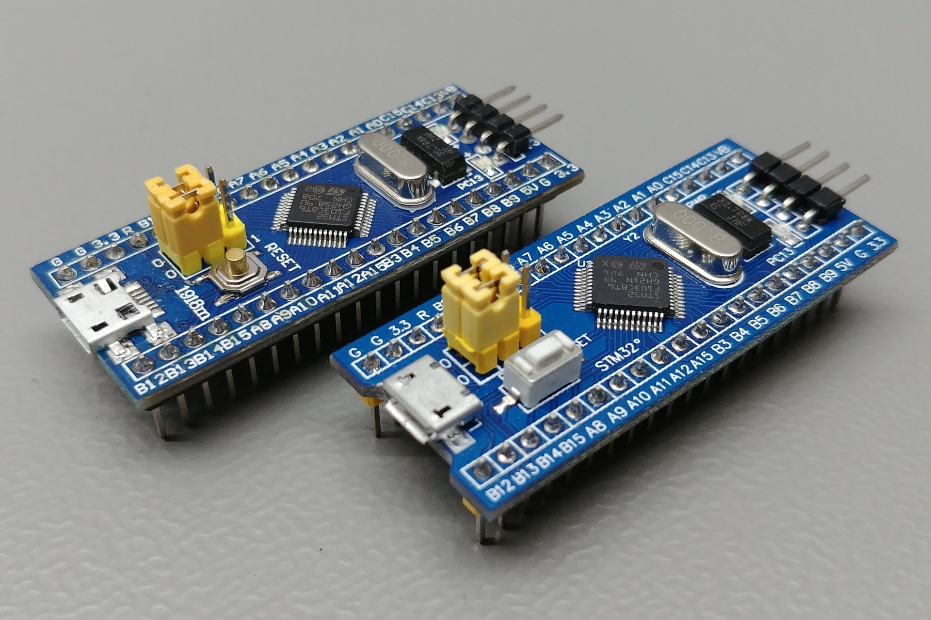
Designs and parts
-HAL 9000 from 2001 A space odyssey (AI Themed) for the shape, colors and appearance of the PCB
-STM32f103c8t6 microcontroller (cheap, lots of open source tools we can borrow)
-Voltmeter, oscilloscope, can transceiver, logic analyzer, continuity tester, power supply (1.2,3v3,5)

Slide 6
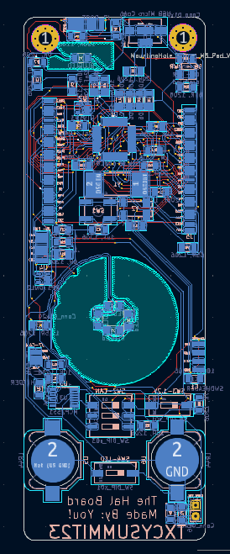
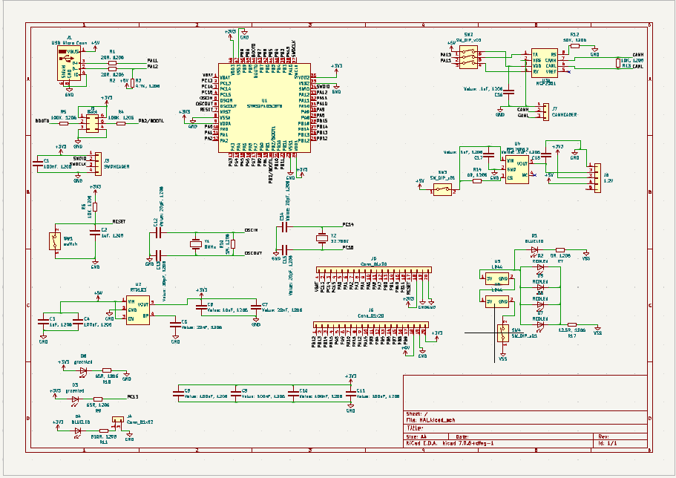
End Product - Schematic and PCB Design

Slide 7
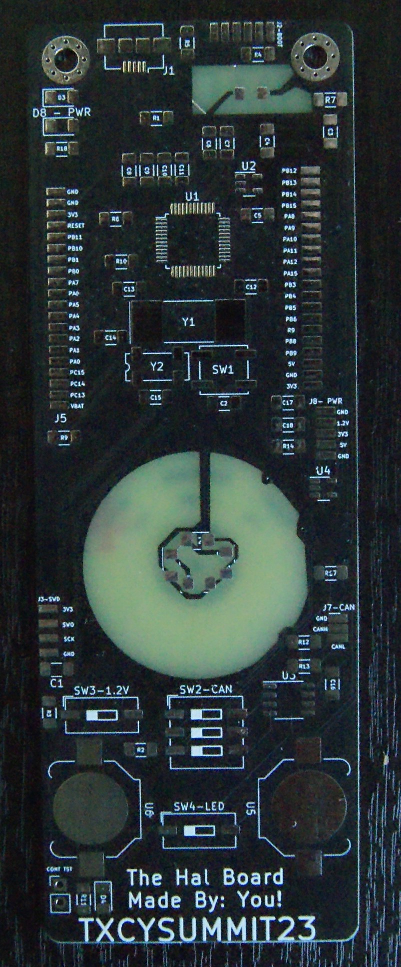
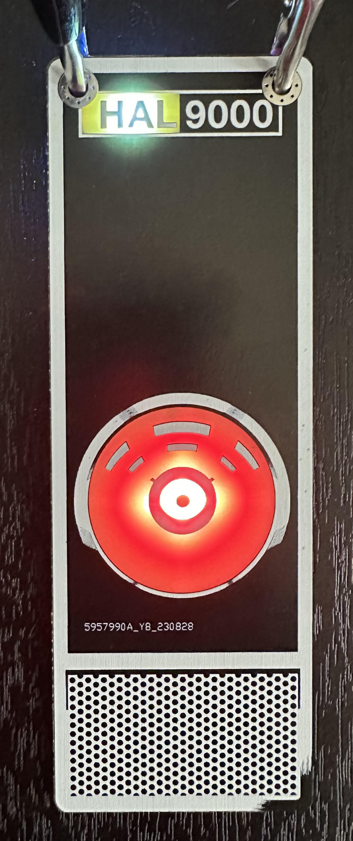
End Product - Actual Fabbed Board

Slide 8
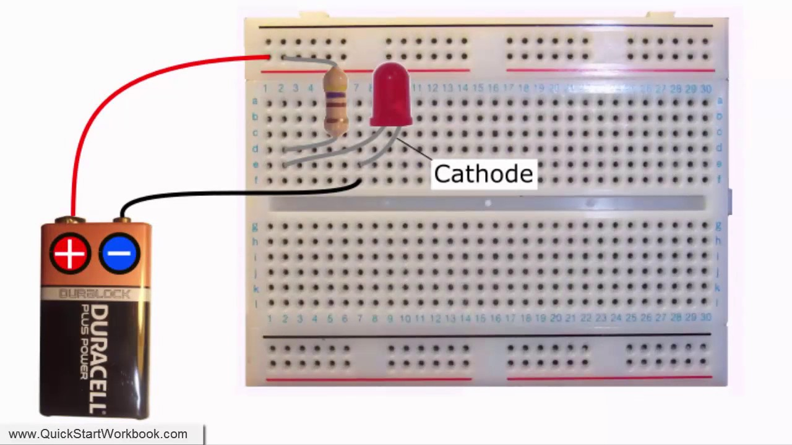
What is a circuit
-To understand how a circuit is made/tool foundation to electronics must be understood and forward development can begin
-Power always tries to find ground and will find the path of least resistance to get there
-Below an example circuit and is powered by a battery of a “fixed voltage” which is adjusted to power the led and keep it in operating parameters

Slide 9
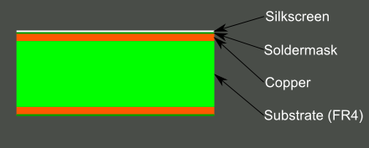
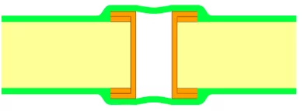
PCB…What is that? Why do I care?
-PCB stands for printed circuit board
-Most PCB’s are made up of fiberglass (FR4), copper traces to connect components, soldermask (color), and silkscreen (white lettering)
-Used to carry electrical signals to components to complete a task or function
-Can be reversed out using a continuity tester and copied
-Circuits made into PCB’s
VIA

Slide 10
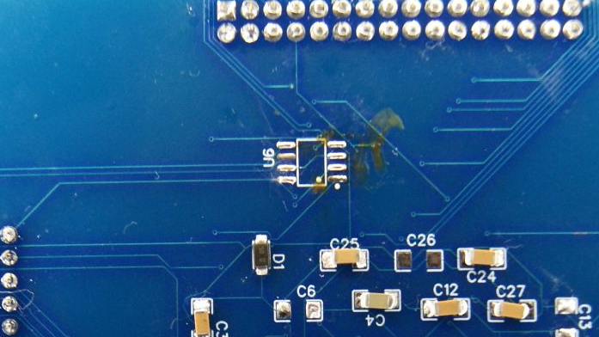
Silkscreen
Traces
VIA
SMD COMPONENTS

Slide 11
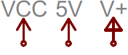

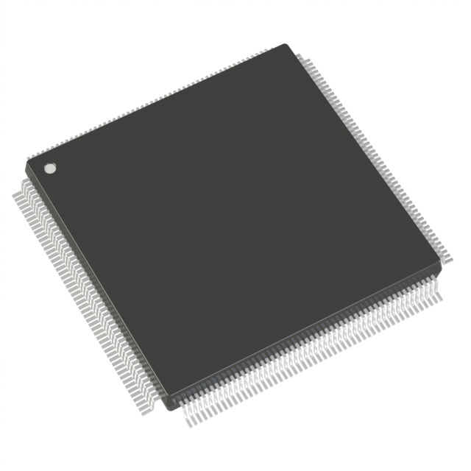
Electrical signals and power on a PCB
-Positive/Voltage (also known as VCC) IE VCC5
-Negative/Ground (also known as vss) IE GND or VSS
-Signals (protocols, data) IE spi, i2c, can, jtag, uart (not noted at all)
-G eneral P urpose I nput O utput signals (can be configured; not noted except for pins)
-Refer to datasheets for proper electrical signals
-Circuits use these signals to be effective

Slide 12
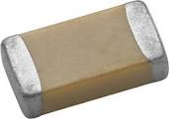
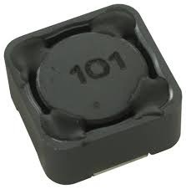
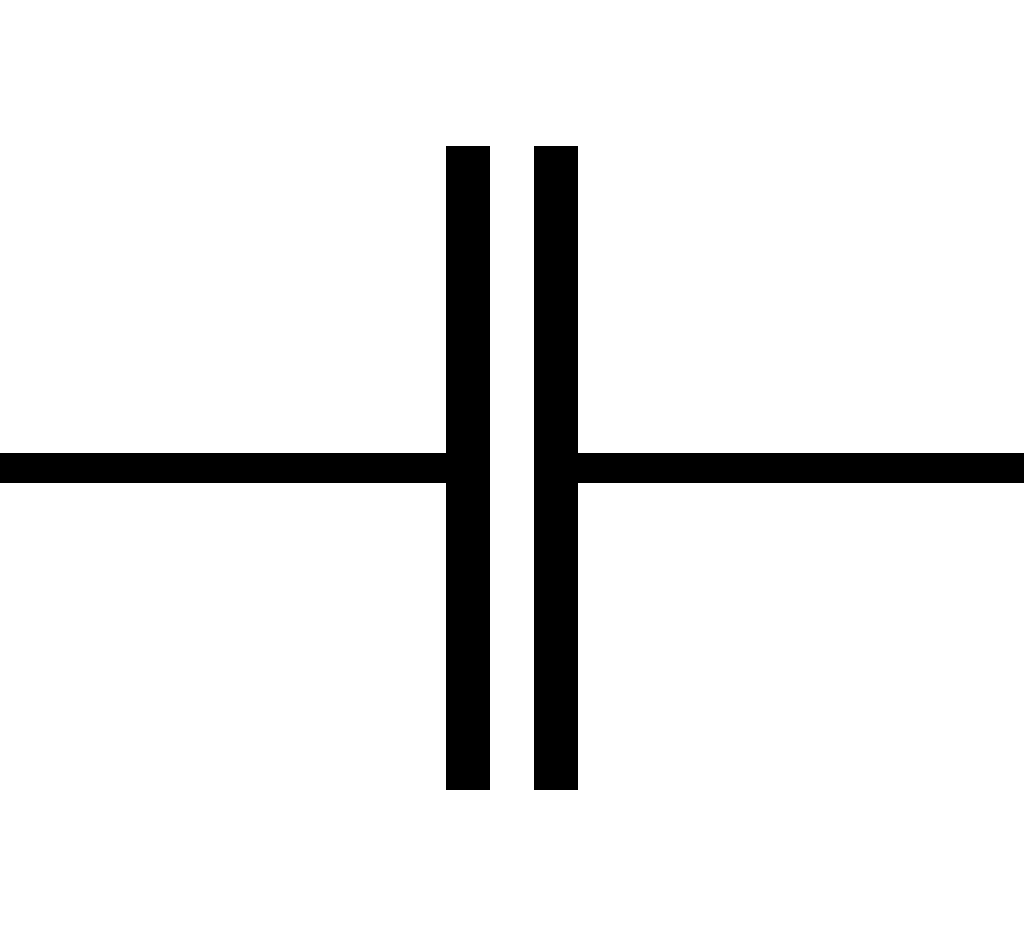
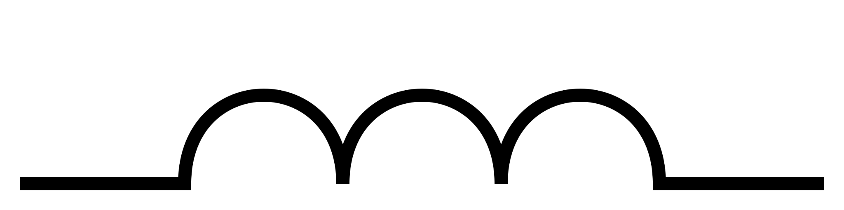

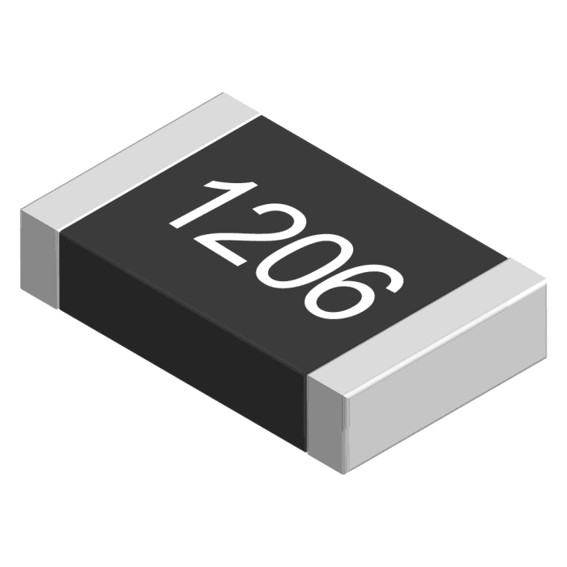
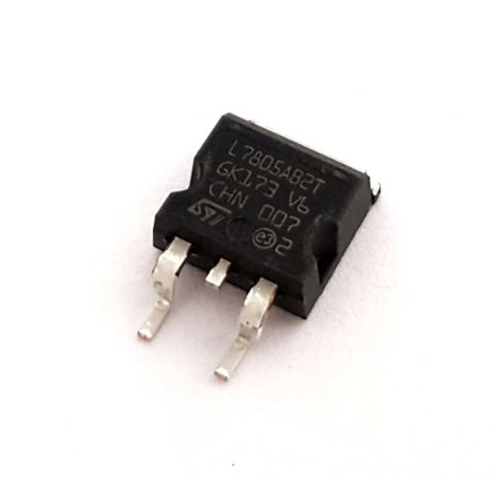
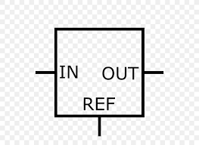
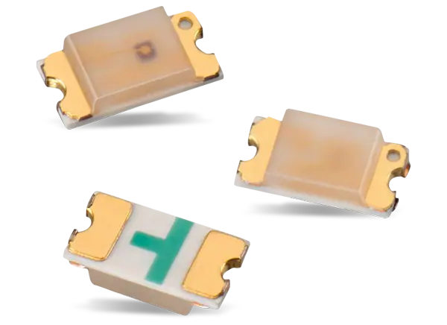
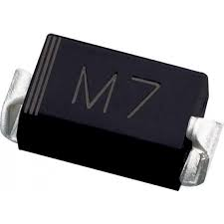
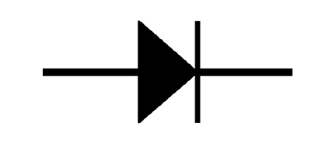
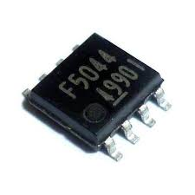
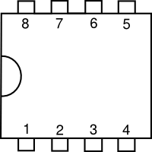
Electronics on a PCB Cont. (components - sometimes free)
Capacitor (and inductor) | Stores energy for safe power down Reduces noise Etc | Cap. Inductor | Cap. Inductor | Cap - C Inductor - L | cap-Farad Inductor- Henry
Resistor | Reduces Voltage/current in circuit |  |  | Resistor - R | Ohm
Regulator | controls voltage in circuit |  |  | Regulator - U | Volts
Diode/LED | Forces flow of power to move in one direction |  |  | Diode - D | power
IC/Clock/ETC… | Other electrical components |  |  | IC - U Other - Y/Q/X…etc | N/A

Slide 13
Electronics Cont. (Datasheets)
-Every electronic part more than likely has one (except proprietary)
-Tells you package information and ratings IE 1206 size and 3.3v at 200mah
-Can be found on website ordering from
-Use this as a reference to almost every electrical component you buy/place onto a tool
-Aquiring the wrong part without consulting the datasheet may cause shorts or electrical issues in the circuit. In fact it more than likely will.

Slide 14
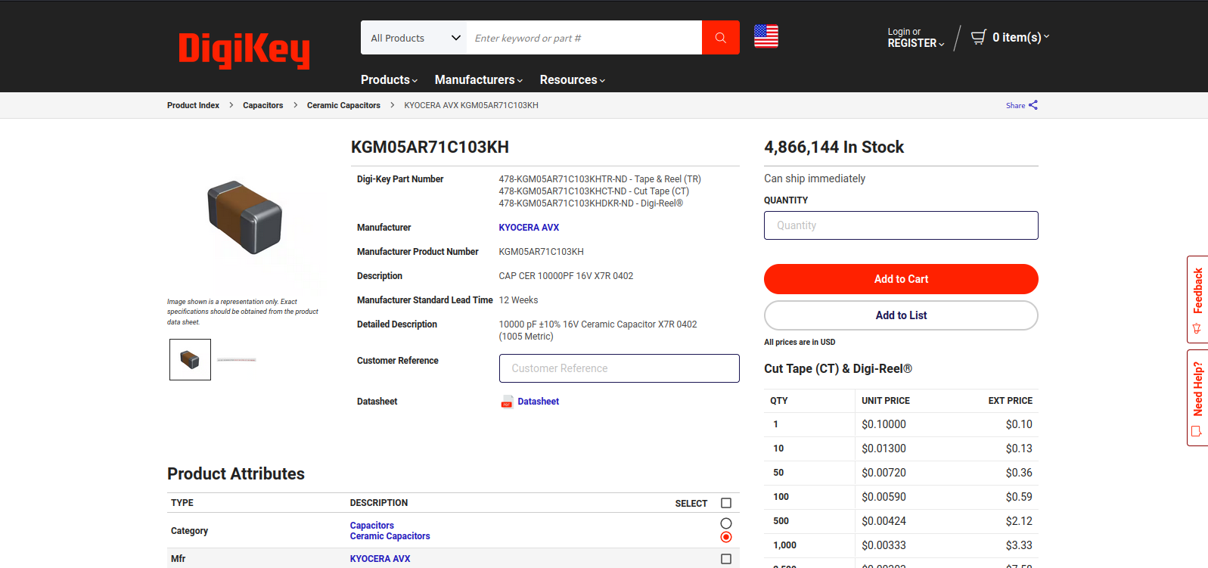

Slide 15
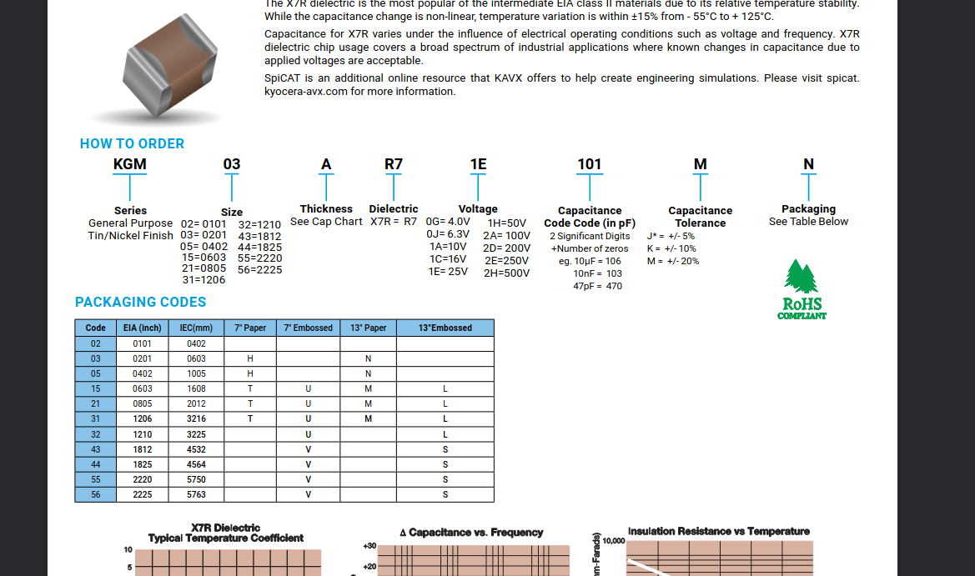

Slide 16
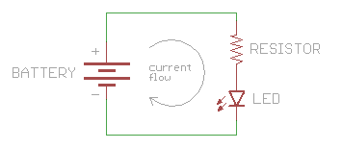
Electronics cont. (Schematic)
-Schematics are used to describe an electrical circuit to carry electricity and signals to the proper components and ultimately to ground
-Helps build out the printed circuit board
-Can also be reverse engineered easily
-Provide a good template to build more projects off of/add to for future tools
-Contain some description of components needed to build the circuit in question
-Needed to build PCB in most cases

Slide 17
The heart of our tool
-STM32F103C8T6 is Arm Cortex-M architecture
-Many open source tools (including the code for the Oscilloscope and other features
-Documentation is … more user friendly
-Cheap
-Lots of tutorials
-Similar microprocessor used in the flipper zero and many other projects

Slide 18
Starting with a Template
-This template has been created making an image into a silkscreen utilizing inkscape and kicad
-Edited attributes of silkscreen
-Utilized properties of clear FR4 to have colors like HAL 9000 (PCB art is very difficult to make with colors due to only having 4 static colors to work with)
-Template reduces the amount of applications needed

Slide 19
Understanding Template
-Template is used for all non functional components of the board
-All art and design elements are created in this template layer
-Template takes hours to make and adjust to look perfect
-Blue and Red LED’s are in a separated closed circuit from the STM32 to keep smaller circuit and extend battery life
-Brightness and power consumption can be adjusted with resistors
-Do not need to populate these components/can delete if not wanted but removes the appearance and aesthetic of the board

Slide 20
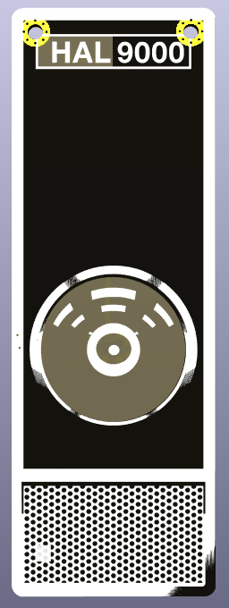
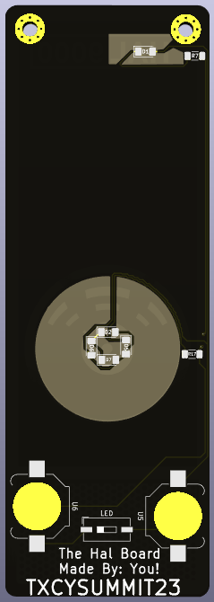
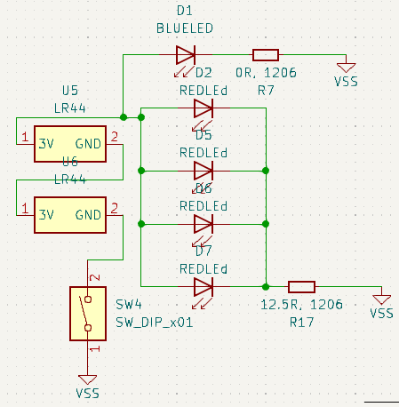
Template Images
NO CHANGE

Slide 21
Understanding Template - Schematic
Batteries/Power source
LED switch
LED’s
Resistors to limit power to LED’s (can be changed to drain slower/have more brightness)

Slide 22
Circuit Power Characteristics
-Power Voltage is ~3v
-Capacity of both batteries around 300Mah
-Can power entire circuit not just the LED’s depending on usage time
-Will not last long, especially if the STM32 and other components are being utilized and on at the time

Slide 23
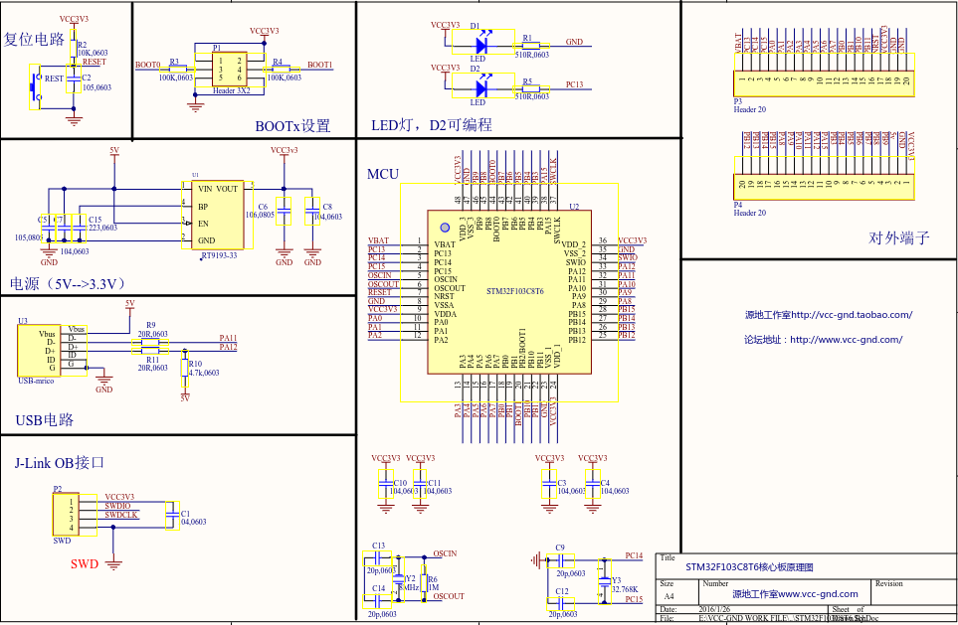
STM32 Schematic

Slide 24
STM32 Schematic - Reverse out and Forward Development
-Reverse Engineering with a schematic (if credible)
-Copy the parts, find what fits online, and place
-Datasheets are your friend to choose the correct part
-Can find much more information about the part with the schematic if available (were making a complete board by reverse engineering a blue pill!)
-Much quicker than pinning out with a multimeter and looking at every trace

Slide 25

Open Kicad … or your PCB/SCH editor of choice

Slide 26
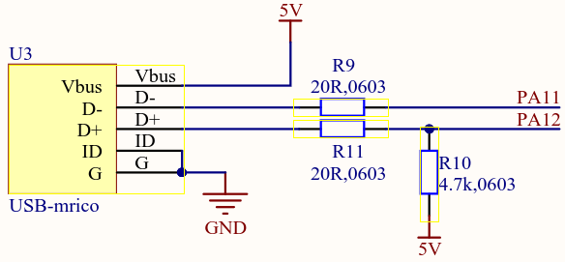
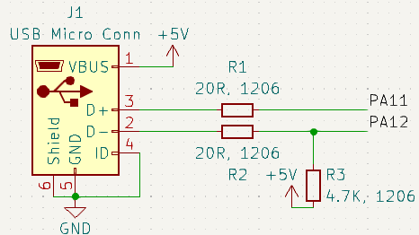
STM32 Schematic - USB Connection

Slide 27
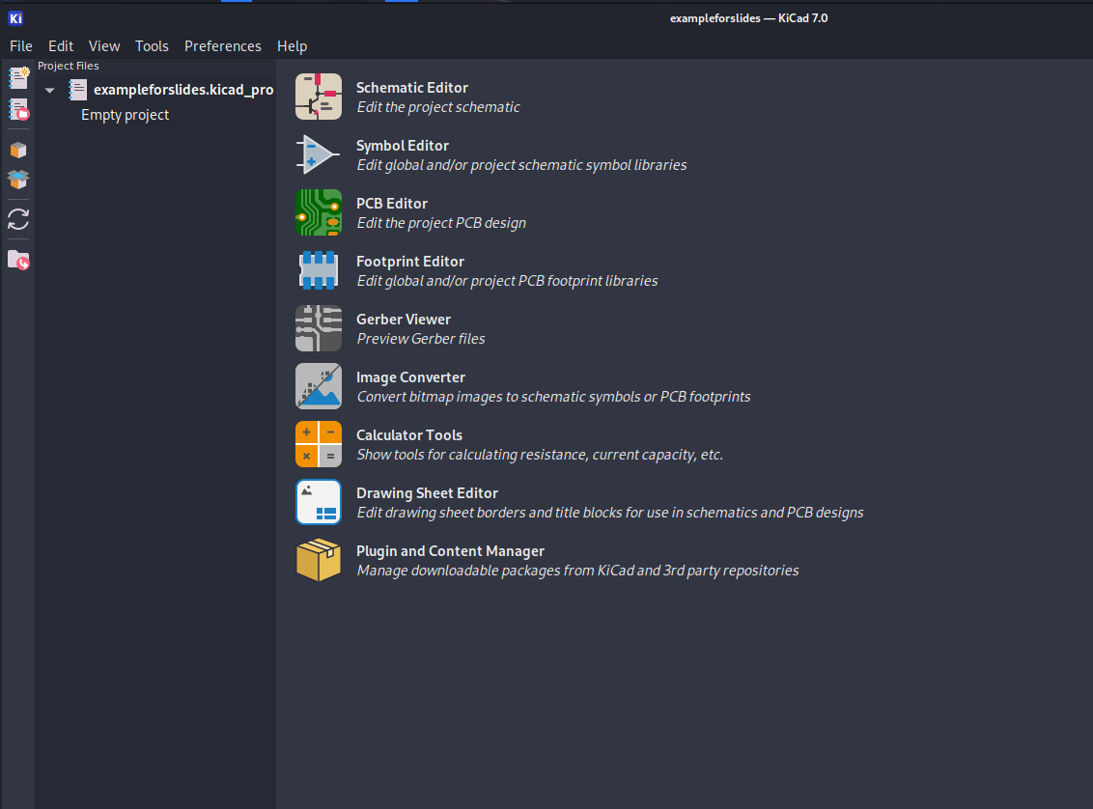
Kicad Setup

Slide 28
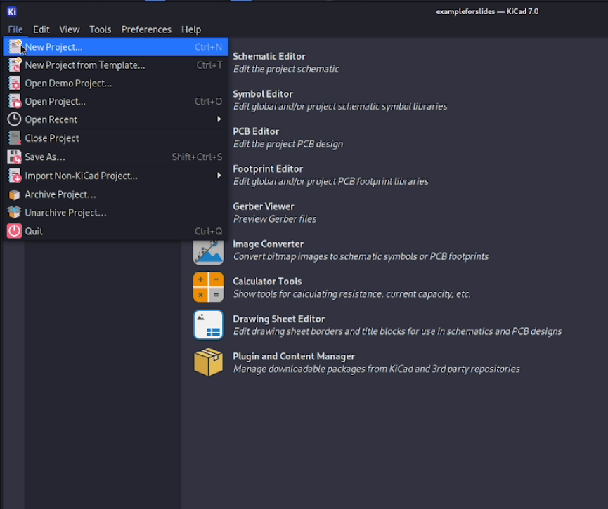
Kicad Setup - New Project *OR USE PROVIDED*

Slide 29
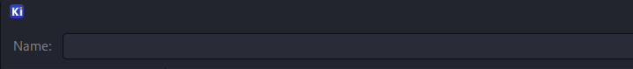
Kicad Setup - Make a name (and place in dir)

Slide 30
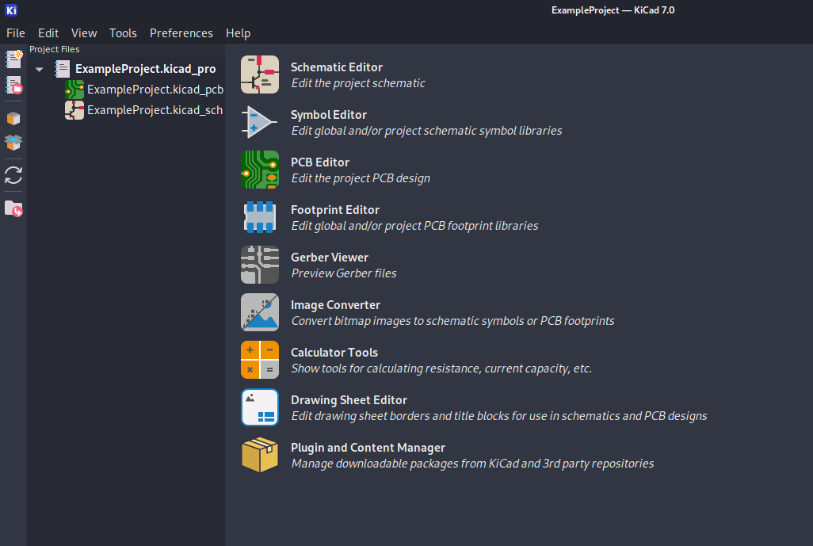
Kicad Setup
-Hierarchy
-PCB File
-Schematic File

Slide 31
Kicad Setup
Self narrated and titled

Slide 32
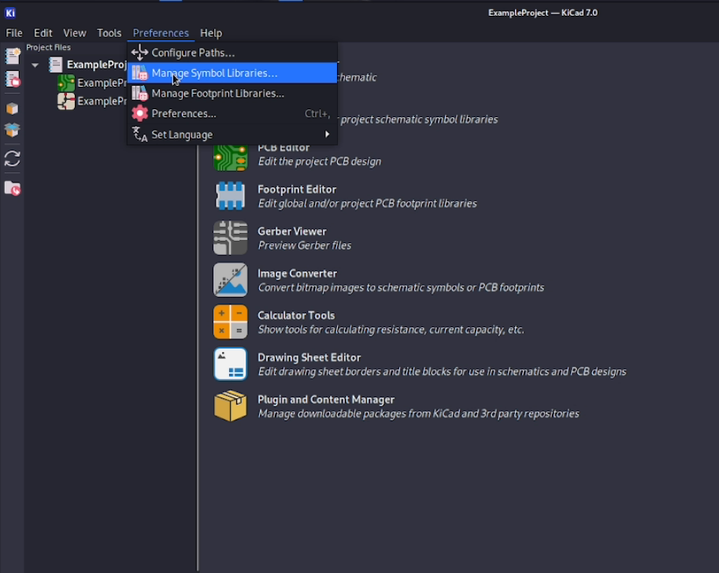
Import Footprints and Symbols
Preferences tab to import all of our custom footprints and symbols to place.

Slide 33
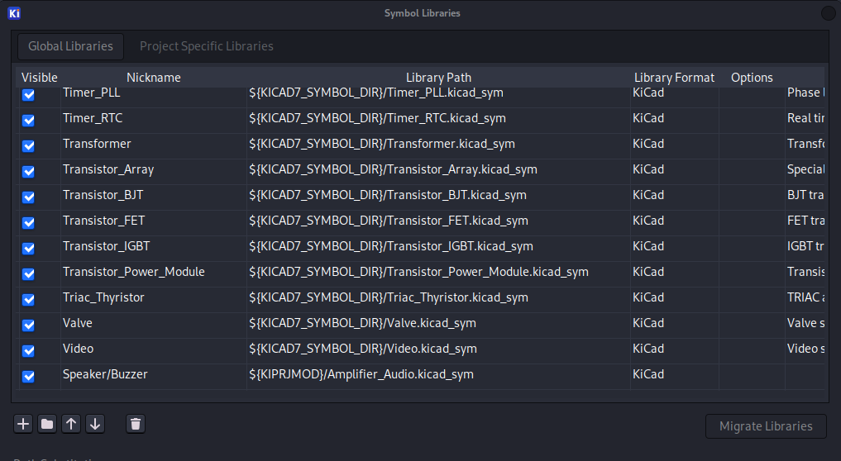
Import Footprints and Symbols
To add footprint/symbol click the + symbol and make a nickname like hal footprints or hal symbols. Do this for both and specify the hal symbols to the symbol library and hal footprints in the footprint library

Slide 34
Open Schematic Editor
After loading the required footprints and symbols, it is time to start building a schematic with Kicad. Click on the schematic editor

Slide 35
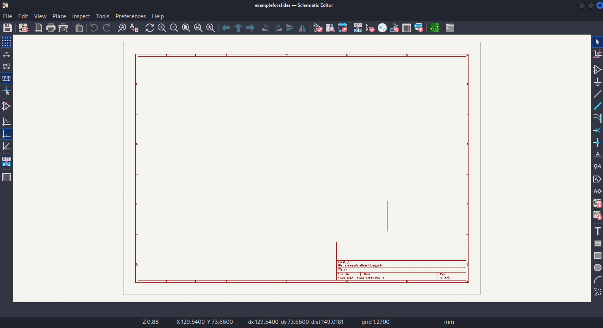
Schematic Editor - An Overview

Slide 36
Schematic Editor Overview
Jump to PCB
Ref. Designator
Footprint Editor
Symbol Browser
Template

Slide 37
Schematic Editor Overview
Connect Wires
Make No Connect
Make Net Labels

Slide 38
STM32 Schematic - USB Connection

Slide 39
STM32 Schematic - USB Connection
Symbol Browser

Slide 40
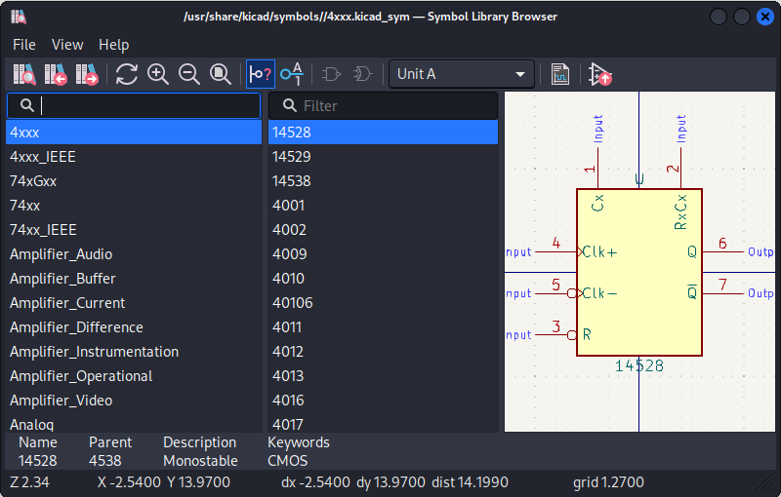
STM32 Schematic - USB Connection
Symbol Browser
Kicad Libraries
Symbols

Slide 41
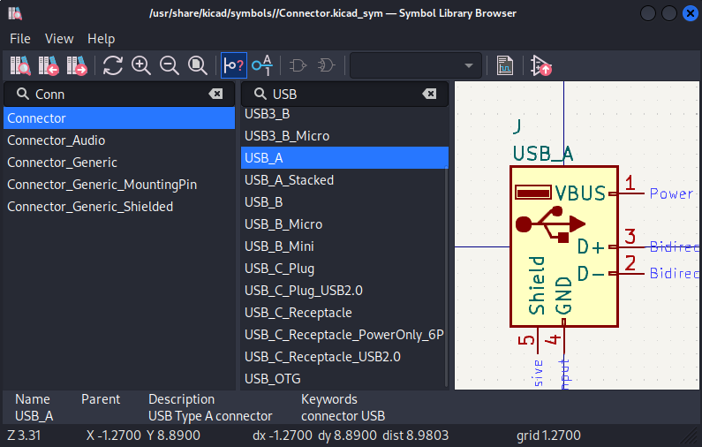
STM32 Schematic - USB Connection
Symbol Browser
Kicad Connector Library
USB A Symbol
Double Click

Slide 42
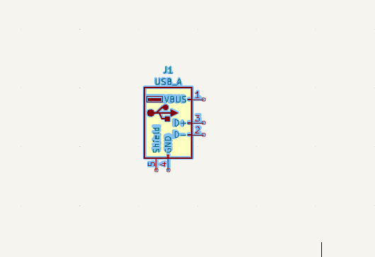
STM32 Schematic - USB Connection
Click once to place inside the template
Hit ESC to deselect the symbol placed and the mouse capture
Click to reselect
Double click to edit the symbol attributes

Slide 43
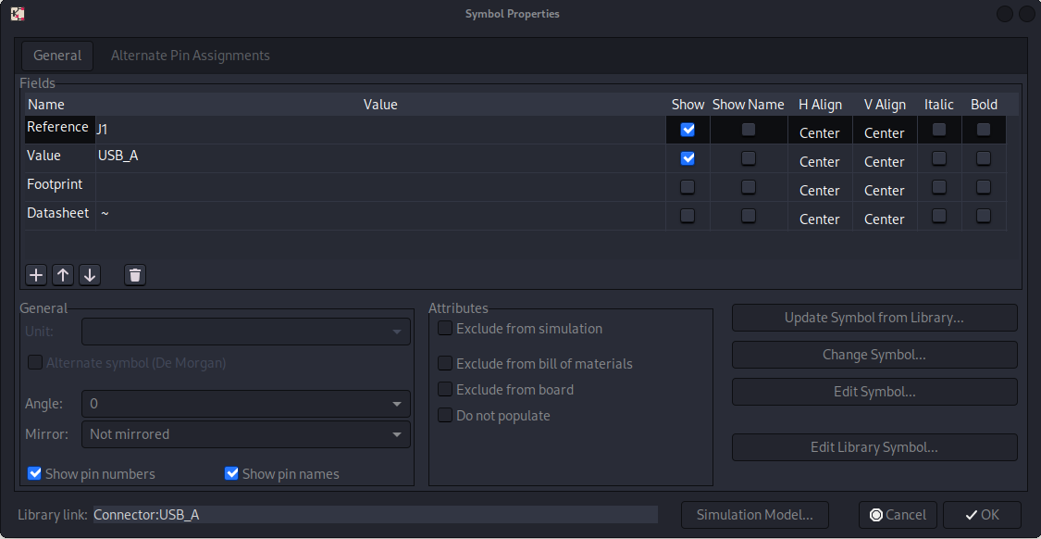
STM32 Schematic - USB Connection
Values to edit

Slide 44
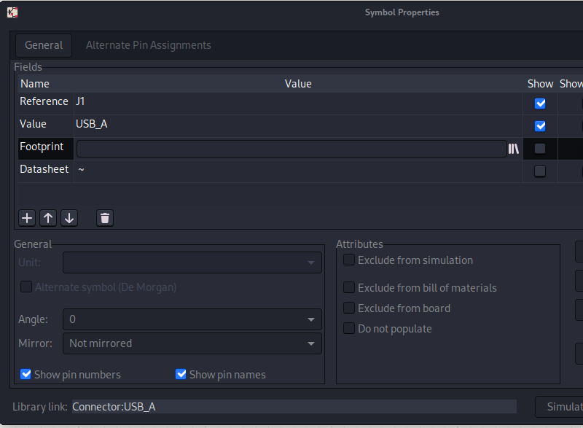
STM32 Schematic - USB Connection
Click on the books to specify footprint

Slide 45
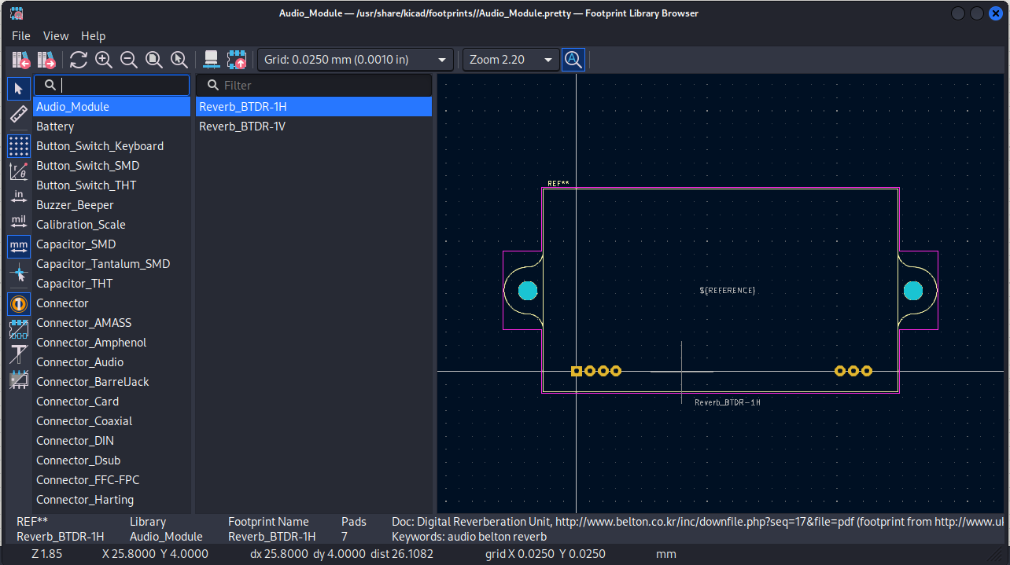
STM32 Schematic - USB Connection
Footprint Library
Footprints

Slide 46
STM32 Schematic - Find a component
-Want component that will not poke through the board and ruin art (no thru hole)
-Want normal USB functionality and even ability to remove from blue pill and place on our board
-USB Micro B connection is on the blue pill
-Need to find component with it (optional but helps

Slide 47
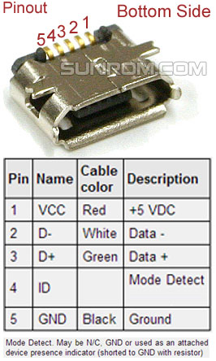
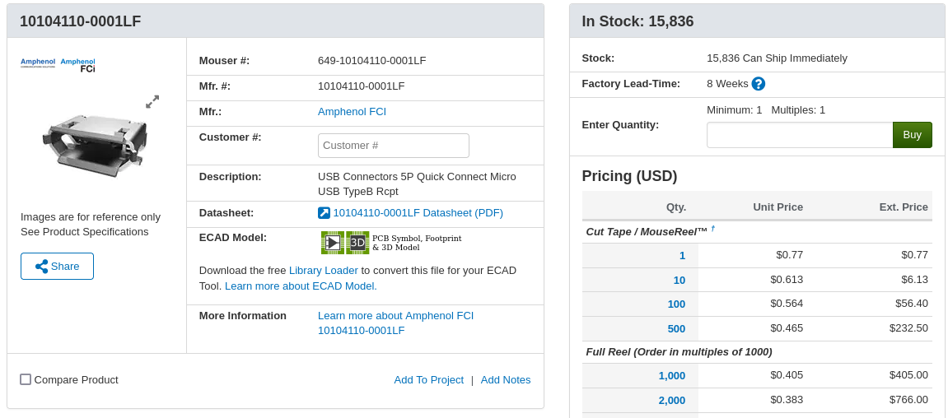
STM32 Schematic - Find a component

Slide 48
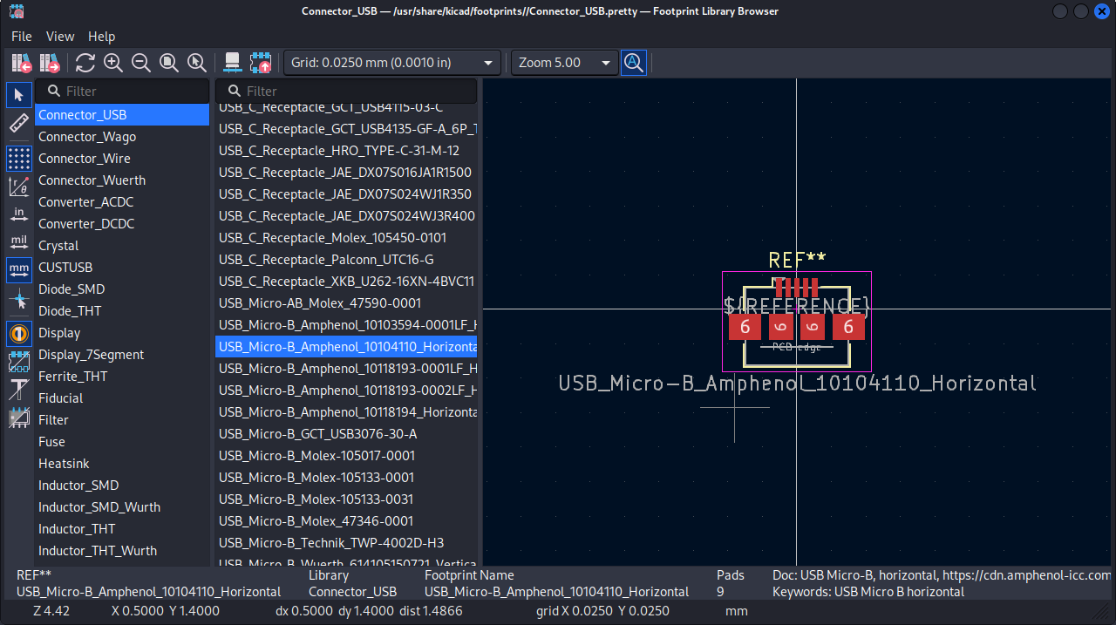
STM32 Schematic - Only one footprint
-Kicad given footprints only contain one non thru hole smd micro USB b connector
*SMD is typically red and thruhole is gold/yellow in kicad
Double Click

Slide 49
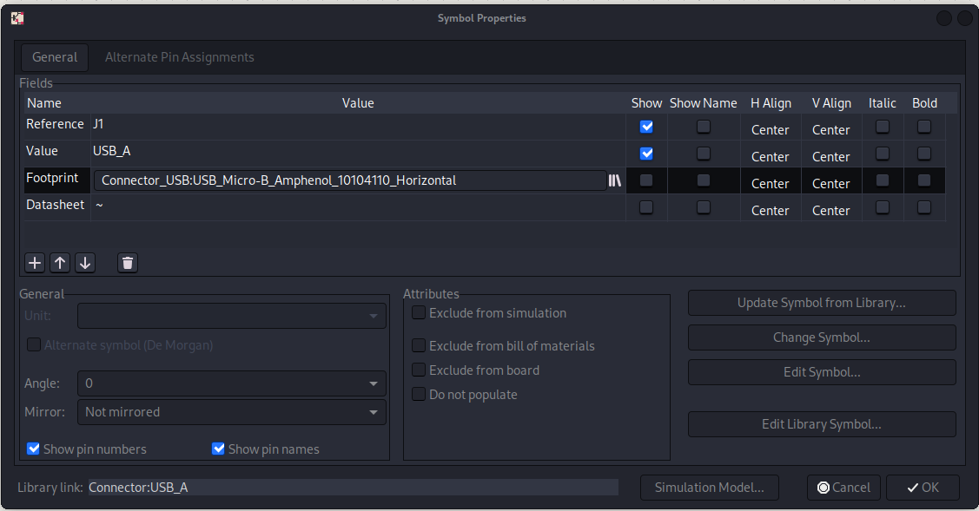
STM32 Schematic - Only one footprint
Footprint has been loaded
Click ok

Slide 50
STM32 Schematic - USB Connection

Slide 51
STM32 Schematic - Placing resistors

Slide 52
STM32 Schematic - Placing resistors
Symbol Browser

Slide 53
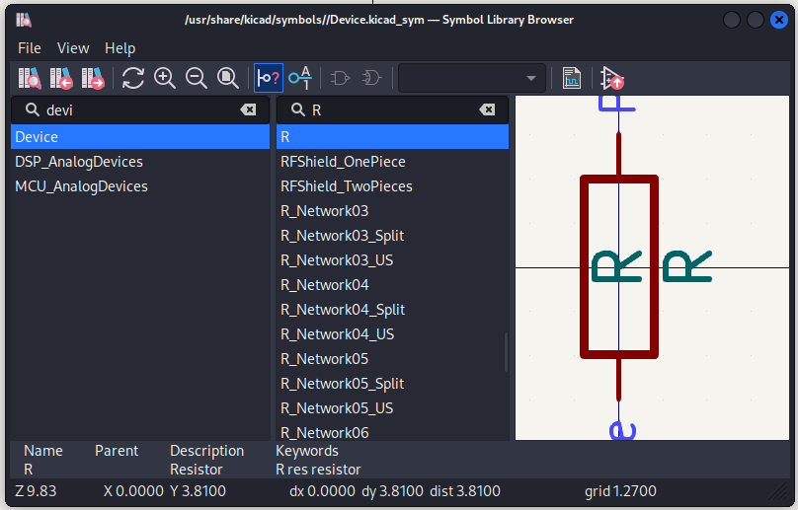

STM32 Schematic - (Double click and place)

Slide 54


STM32 Schematic - Placing resistors
Hit R key while selected to rotate

Slide 55

STM32 Schematic - Placing resistors
CTRL+C and CTRL+V or right click copy/paste for multiples
Drag values and designators around for adequate spacing

Slide 56

STM32 Schematic - Component packaging for footprint

Slide 57

STM32 Schematic - Google says use 0805

Slide 58

STM32 Schematic - Choosing Resistor footprint

Slide 59

STM32 Schematic - Choosing Resistor footprint

Slide 60

STM32 Schematic - Choosing Resistor footprint
Footprint Loaded
Hit ok

Slide 61


STM32 Schematic - Choosing Resistor footprint
Change Value to be similar to schematic

Slide 62

STM32 Schematic - Route Wires/Connections
Keypress w or click the circle on a component to start a connection wire

Slide 63

STM32 Schematic - Route Wires/Connections
Connect all components in the Schematic (essentially clone)

Slide 64
STM32 Schematic - Power and Ground
Symbol Browser

Slide 65

STM32 Schematic - Power and Ground

Slide 66

STM32 Schematic - Power and Ground

Slide 67
STM32 Schematic - Power and Ground
Symbol Browser

Slide 68

STM32 Schematic - Power and Ground

Slide 69

STM32 Schematic - Power and Ground

Slide 70
STM32 Schematic - Add pins to Nets
Add Nets

Slide 71
STM32 Schematic - Placing nets

Slide 72

STM32 Schematic - Add pins to Nets
Add Net label from schematic

Slide 73

STM32 Schematic - Add pins to Nets

Slide 74
STM32 Schematic - Add pins to Nets

Slide 75

USB CONN COMPLETED! Lets walk through one more

Slide 76

STM32 Schematic - Voltage Regulator
-Voltage regulator is used to reduce the voltage to the components
-STM32 runs off of 3v3 not 5v circuit and is found in the datasheet in the operating conditions here or in the files provided

Slide 77


STM32 Schematic - Voltage Regulator
-Voltage regulator is the RT9193-33
-Datasheet states that it is a SOT-23-5 package
-Need to find SOT-23-5 package symbol and footprint

Slide 78
STM32 Schematic - Voltage Regulator
Symbol Browser

Slide 79

STM32 Schematic - Voltage Regulator
Choose this symbol. We are going to make it into our own custom symbol to match the pinout of the schematic

Slide 80

STM32 Schematic - Voltage Regulator
After placing on schematic, right click and select edit with symbol editor

Slide 81

STM32 Schematic - Voltage Regulator
In symbol editor, a user has more control to edit and change a symbol. In this case, I will change the PIN names, remove the datasheet, change the value, and move the pins and shape

Slide 82


STM32 Schematic - Voltage Regulator
Select border and stretch it to match schematic

Slide 83


STM32 Schematic - Voltage Regulator
Move the pins around to also match

Slide 84

STM32 Schematic - Voltage Regulator
Change the Value to match the schematic

Slide 85


STM32 Schematic - Voltage Regulator
Remove Datasheet and excess light blue gibberish we dont need by inputting null to message box

Slide 86


STM32 Schematic - Voltage Regulator
Change the pin names to match the schematic and datasheet CTRL+S this part

Slide 87

STM32 Schematic - Voltage Regulator
Change electricity flow direction (not really necessary and can be avoided by using bidirectional on everything) Exit the Symbol Editor

Slide 88

STM32 Schematic - Voltage Regulator
Symbols should now match

Slide 89
STM32 Schematic - Voltage Regulator Capacitors

Slide 90
STM32 Schematic - Voltage Regulator
Symbol Browser

Slide 91

STM32 Schematic - Voltage Regulator
Select Device library and go to C symbol

Slide 92

STM32 Schematic - Voltage Regulator
Place, copy, paste capacitors

Slide 93

STM32 Schematic - Voltage Regulator
Route Tracks
Dots signify connections … no dot means the wires are not connected

Slide 94
STM32 Schematic - Voltage Regulator
Symbol Browser

Slide 95

STM32 Schematic - Voltage Regulator

Slide 96

STM32 Schematic - Voltage Regulator Power and GND
Placed GNDS and even made an edit to improve the schematic (IMO)

Slide 97
STM32 Schematic - Voltage Regulator
Symbol Browser

Slide 98


STM32 Schematic - Voltage Regulator

Slide 99

STM32 Schematic - Voltage Regulator Power and GND
Placed 3V3 and 5V pins respectively on schematic to match

Slide 100

STM32 Schematic - Voltage Regulator Change CAP values
Change values to match the schematic (We are again going to use the 0805 package size, same as resistors)
Values such as 105 can be looked up and translated if needed just lookup capacitor number marking #

Slide 101

STM32 Schematic - Voltage Regulator Change CAP Footprint
0805 Footprint hand solder

Slide 102

STM32 Schematic - Voltage Regulator Footprint
Open the footprint browser

Slide 103

Need footprint with same package
-Voltage regulator is the RT9193-33
-Datasheet states that it is a SOT-23-5 package
-Need to find SOT-23-5 package symbol and footprint

Slide 104
STM32 Schematic - Voltage Regulator Footprint
Open the footprint browser

Slide 105
STM32 Schematic - Voltage Regulator Footprint
Voltage Regulator Complete

Slide 106


Slide 107

STM32 Schematic - Reset Switch
Symbol:Resistor
Footprint:0805HandSolder
Symbol:Capacitor
Footprint:0805HandSolder
Symbol:Switch
Footprint:Dip Switch

Slide 108

STM32 Schematic - Reset Switch
Symbol:Resistor
Footprint:0805HandSolder
3V3
BOOT0 Net
BOOT1 NET
Symbol:Header3x2
Footprint:BOOTH
GND

Slide 109

STM32 Schematic - Reset Switch
Symbol:Header4x1
Footprint:SWDH
3V3
SWDIO NET
Symbol:CAPACITOR
Footprint:0805HandSold
SWDCK Net
GND

Slide 110

STM32 Schematic - PWR LED
LED RESISTOR CALC
Symbol:Diode/LED
Footprint:0805HandSolder
GND
3v3
Symbol:CAPACITOR
Footprint:0805HandSold
PC13 NET

Slide 111

STM32 Schematic - 8Mhz Clock
Symbol:Capacitor
Footprint:0805HandSolder
OSCIN NET
Symbol:Resistor
Footprint:0805HandSold
GND
OSCOUT Net
Symbol:Device:Crystal
Footprint: Crystal:Search for “MA505”

Slide 112

STM32 Schematic - 32.768Khz Clock
Symbol:Capacitor
Footprint:0805HandSolder
PC14 NET
GND
PC15 Net
Symbol:Device:Crystal
Footprint: Crystal:Search for “MC306”

Slide 113

STM32 Schematic - Decoupling Capacitors (for voltage drops)
Symbol:Capacitor
Footprint:0805HandSolder
3V3
GND

Slide 114

STM32 Schematic - Copy STM32 Symbol over (contains footprints)

Slide 115

STM32 Schematic - STM32 Headers to break out
Power Pins
Nets

Slide 116

STM32 Schematic - Continuity Tester
Optional Buzzer
Symbol: Conn 2x1
Footprint: Header: 2x1
Self Explanatory

Slide 117

Adding features to our STM32

Slide 118

STM32 Schematic 1.2 Volt Regulator
Self Explanatory

Slide 119

STM32 Schematic CAN BUS communication
Self Explanatory

Slide 120

STM32 Schematic CAN BUS communication
Add SW5 DIP Switch

Slide 121

STM32 Schematic CAN BUS communication
Click PCB Editor

Slide 122

STM32 Schematic CAN BUS communication
Update PCB from schematic

Slide 123

STM32 Schematic CAN BUS communication
Update PCB

Slide 124

STM32 PCB Remove all duplicate footprints

Slide 125


STM32 PCB Place Footprints

Slide 126

STM32 PCB Configure Diff pair and route for USB (cng nets to +,-)

Slide 127

STM32 PCB Autoroute (You may need to import)
Autoroute

Slide 128

STM32 PCB Autoroute

Slide 129

STM32 PCB Autoroute

Slide 130

STM32 PCB Autoroute

Slide 131

STM32 PCB Autoroute

Slide 132

STM32 PCB Autoroute

Slide 133

STM32 PCB Autoroute

Slide 134

STM32 PCB Autoroute

Slide 135
STM32 PCB Autoroute

Slide 136

STM32 PCB Autoroute

Slide 137

STM32 PCB Autoroute
Click on Autorouter and autorouter will begin. After autorouter is done, it will populate your PCB with traces

Slide 138

STM32 PCB Export Gerbers
Visually ensure there are no issues/overlaps/connected nets or errors in the autoroute board

Slide 139

STM32 PCB Export Gerbers
Output the files as gerber files

Slide 140

STM32 PCB Export Gerbers
Choose output directory

Slide 141
STM32 PCB Export Gerbers
Click Plot

Slide 142
STM32 PCB Export Gerbers
Click Generate Drill Files

Slide 143

STM32 PCB Export Gerbers
Click Generate Drill Files and generate map file

Slide 144

STM32 PCB Fabricate
Zip Up the output directory that has the gerber files and upload to a website like JLCPCB or OSHPARK
You can then have your PCB built and manufactured

Slide 145
Questions?

